Slide 1
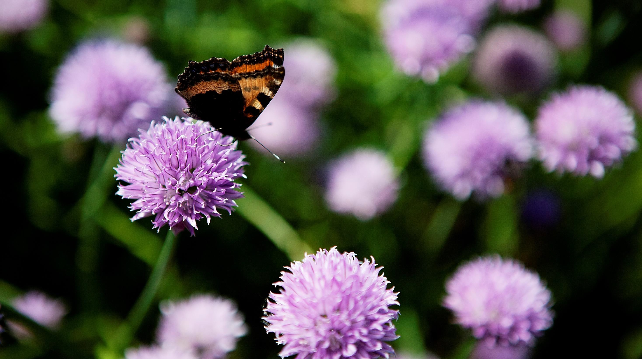
Organic farming and food market in Denmark
Mr. Ejvind Pedersen, Manager
Organic Food and Farming - Danish Agriculture & Food Council Copenhagen, November 27 2018

Slide 2
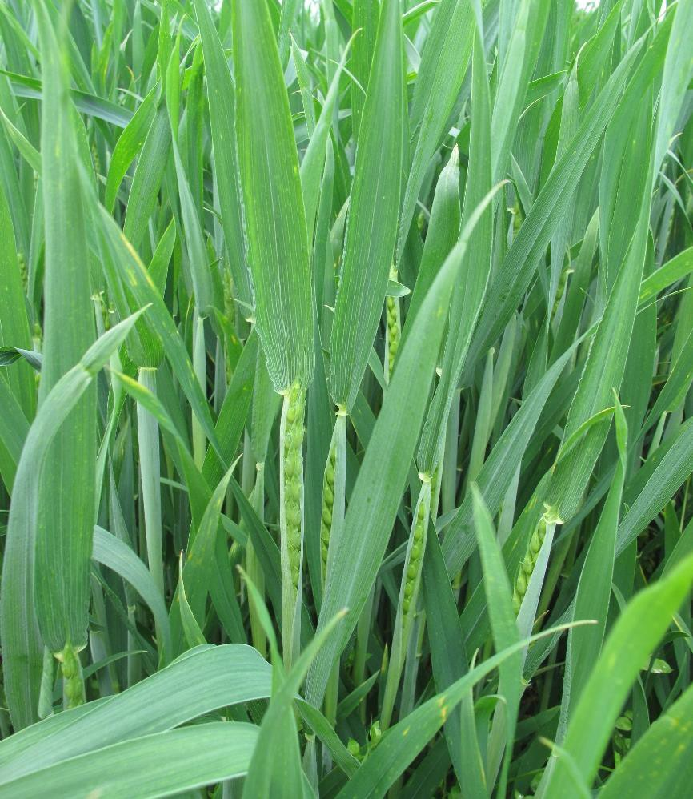
Agenda
Organic farming and production
Organic food market and consumption
Danish policy to promote organic farming

Slide 3
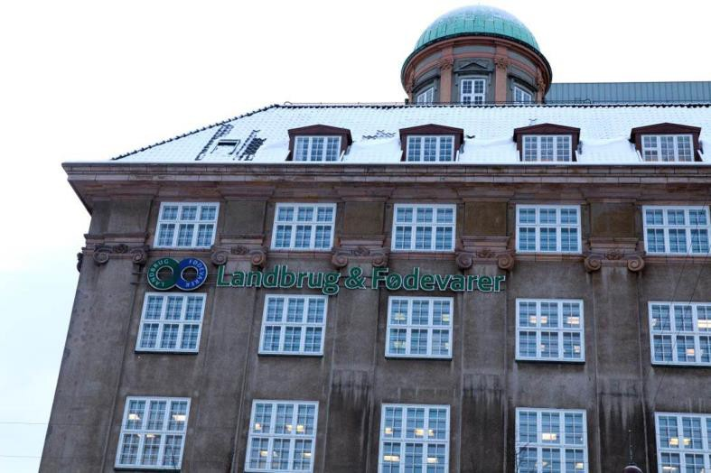
Organic farming in the Danish Agriculture & Food Council
Politics, communication, marketing and trade, advisory services
1500 organic farmers are members through local farmers’
associations
Companies, representing more than 80% of organic sales
Organic food and farming department at Axelborg and Aarhus
Trade and business activities from Axelborg
SEGES Organics – knowledge centre in Jutland
DLBR Danish Organics – 80 organic consultants employed in local
farmers’ associations

Slide 4
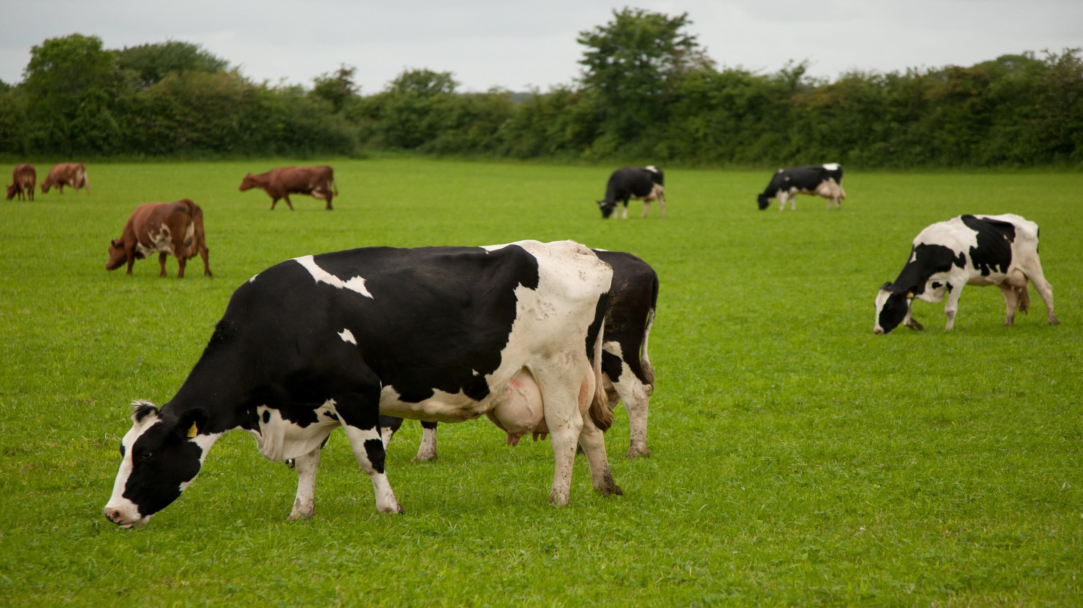
Organic farming and production

Slide 5
World: Growth of the organic agricultural land
Million hectares
70
60
57.8 Million
50
40
30
20
10
0
1999 2000 2001 2003 2004 2005 2006 2007 2008 2009 2010 2011 2012 2013 2014 2015 2016
Source : FiBL, IFOAM and SOEL 1999-2018

Slide 6
Agricultural organic land in some EU-countries in 2016
Thousand hectare
Spain
Italy France Germany Austria
Sweden Poland
UK
Czech Republic
Greece Latvia Portugal Denmark
2019
1795
1537
1251
571
553
EU28
537
11,1
12
490
489
9,4
10
10,1
10,2
9
Million hectare
343
259
245
217
2010 2011 2012 2013 2014 2015 2016
Source: AMI, Eurostat and FiBL

Slide 7
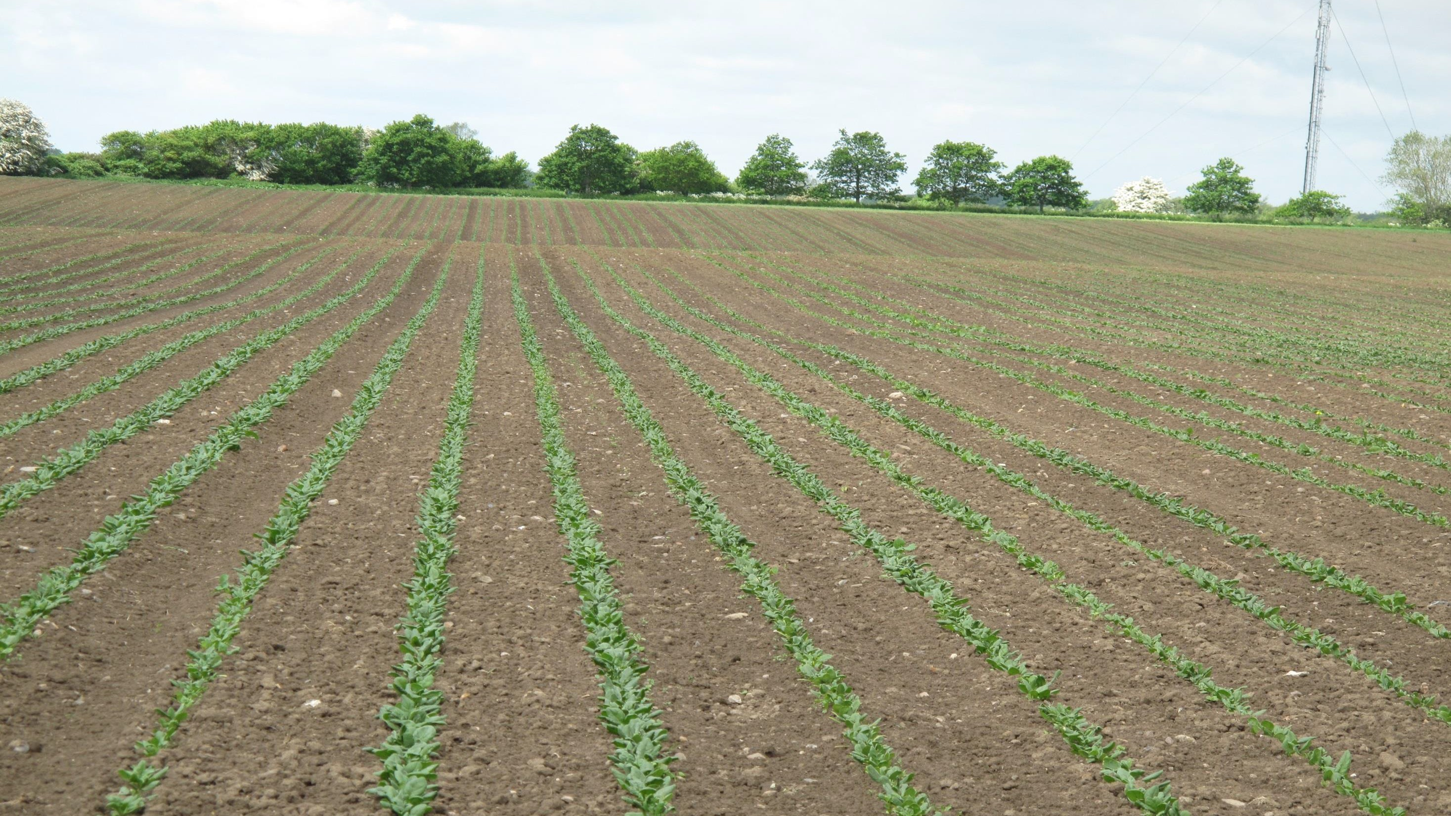
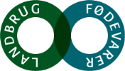
The organic farm land in Denmark
Hectares
380,000
330,000
280,000
245,000
230,000
180,000
130,000
2007 2008 2009 2010 2011 2012 2013 2014 2015 2016 2017 2018 2019 2020
Source: Statistics Denmark
Best estimates for 2018-2020.

Slide 8
Organic land area, by crop – incl. area under organic conversion
250,000
200,000
Other crops Set-aside land Horticulture Seed
Roots Pulses
Grass/green fodder Grain
Hectares
150,000
100,000
50,000
0,000
2012
2013
2014
2015
2016
2017
Source: Statistics Denmark

Slide 9
Operating result for full-time crop producers
DKK
800,000
700,000
600,000
500,000
400,000
300,000
200,000
100,000
0,000
Organic 506,000 DKK ~ € 68,000
Organic Conventional
2011
2012
2013
2014
2015
2016
2017
Source: SEGES

Slide 10
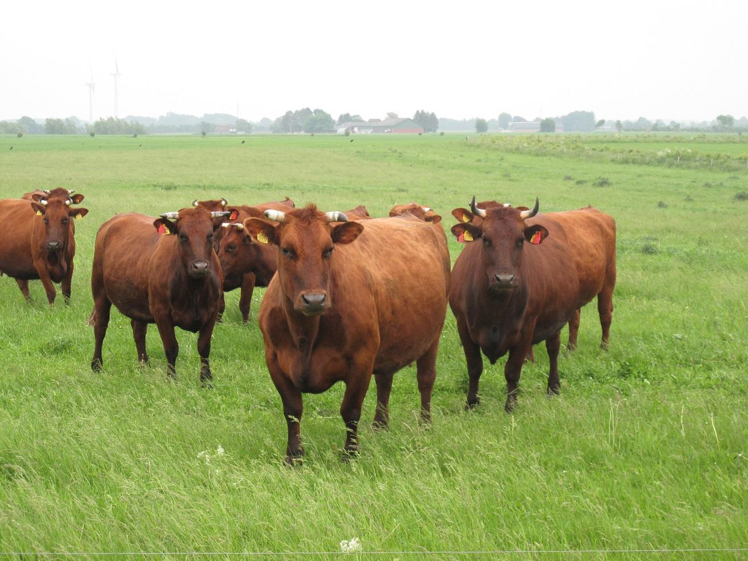
Farming and production 2017
Farming
8.8% of all farms are authorized organic
(3,500 farms)
9.2% of all agricultural farm land is cultivated organically (245,159 hectares)
The average size of an organic farm is 73 ha – compared with 68 ha for a conventional farm
The dairy sector is the ‘driver’ for the organic
development

Slide 11
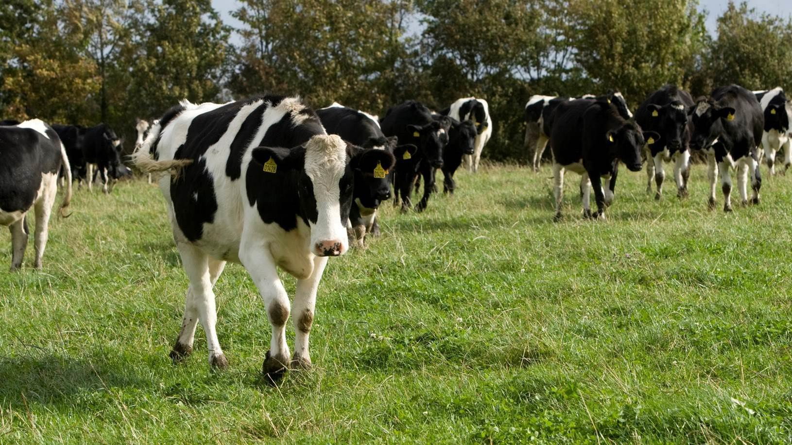
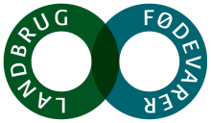
Organic milk production
400 dairy farms and 594 million kg in 2017 or 11% of total milk production in 2017
Organic premium paid by Arla is 8 Cent per kg milk as at 1 November 2018.
32% of drinking milk sold in retail stores is organic.

Slide 12
Production of organic milk
Million kg
800
700
600
500
400
300
200
100
0
720 Million
2007 2008 2009 2010 2011 2012 2013 2014 2015 2016 2017 2018 2019 2020
Source: Statistics Denmark Best estimates for 2018-2020

Slide 13
Operating result for full-time milk producers
DKK
1.800.000
1.600.000
1.400.000
1.200.000
1.000.000
800.000
600.000
400.000
200.000
0
-200.000
-400.000
1.5 Million DKK ~ € 204,000
Organic Conventional
2010 2011 2012 2013 2014 2015 2016 2017
Source: SEGES

Slide 14
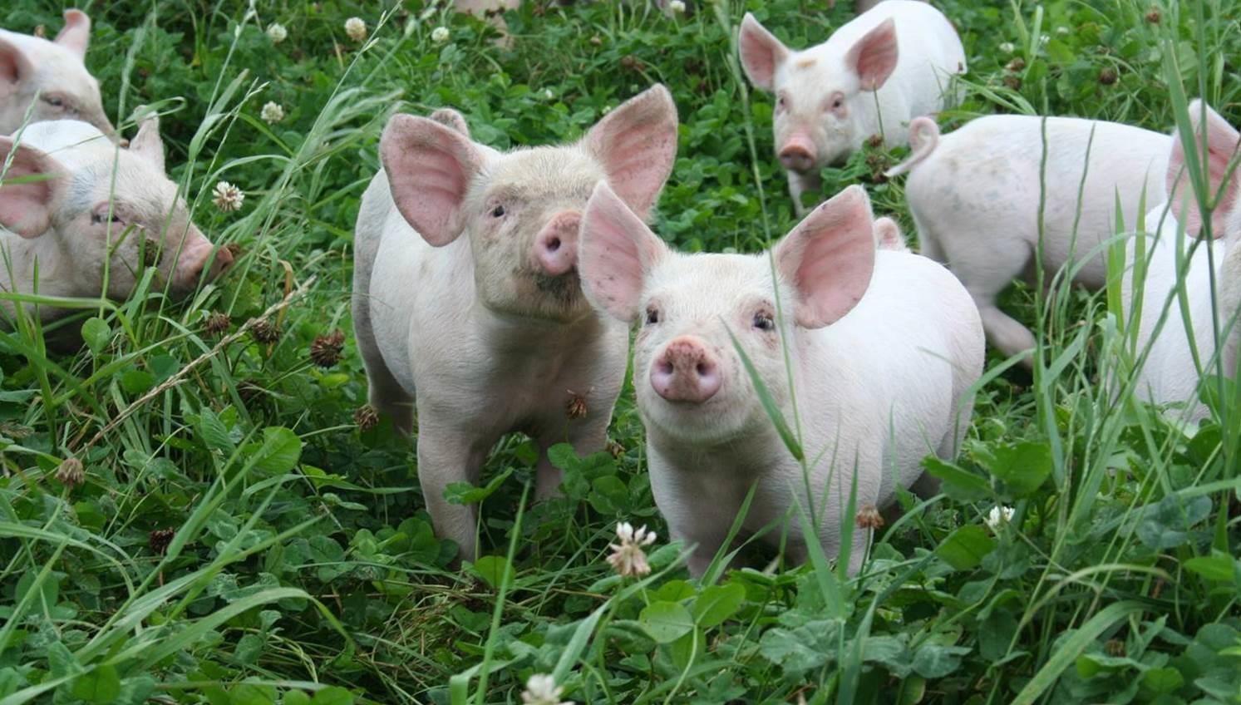
Organic pig production
In 2017 168,000 organic pigs were slaughtered – or 1% of total production
Organic premium paid by Friland is EUR 1.78 per kg as at November 2018
3.5% of sale in retail is organic in 2017

Slide 15
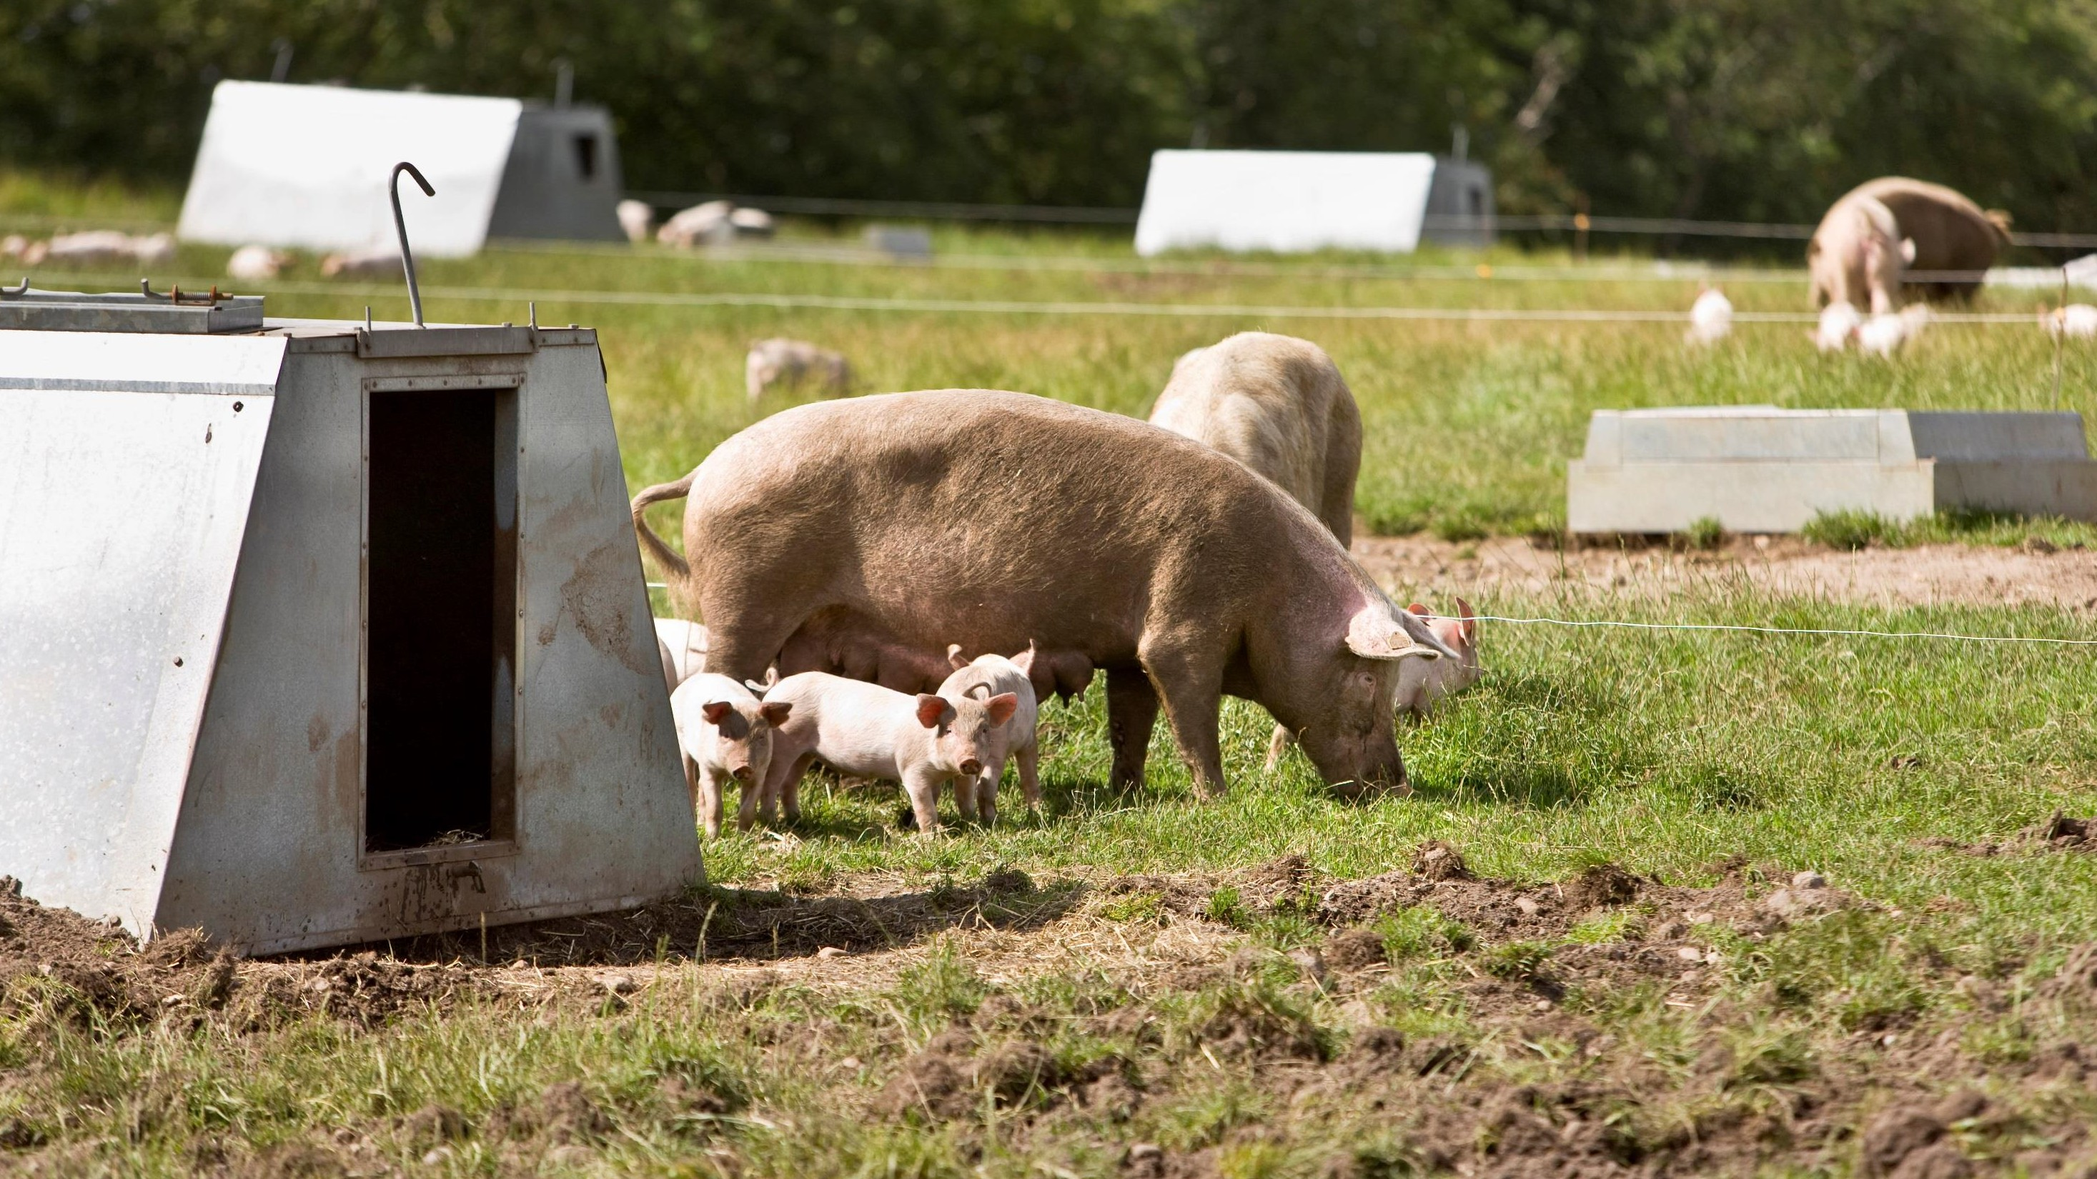
The Danish organic pigfarm
Around 70 organic farmers have a siginificant income from pig production – 230 organic farms has registred pigs
10-1000 sows/holding, but a fair share with approx. 200 sows and production of 4,600 slaughter pigs
12% of the pig farms counts for more than 75% of the total production
Largest pig farm deliver about 25,000 slaughter pigs per year

Slide 16
Production of organic pork
Numbers of pigs 250,000
230,000
200,000
150,000
100,000
50,000
0,000
2007 2008 2009 2010 2011 2012 2013 2014 2015 2016 2017 2018 2019 2020
Source: Statistics Denmark Best estimates for 2018-2020

Slide 17
Operating result for full-time pig producers
DKK
3.000.000
2.500.000
2.000.000
1.500.000
1.000.000
500.000
0
-500.000
-1.000.000
1.7 Million DKK ~ € 232,000
Organic Conventional
2011
2012
2013
2014
2015
2016
2017
Source: SEGES

Slide 18
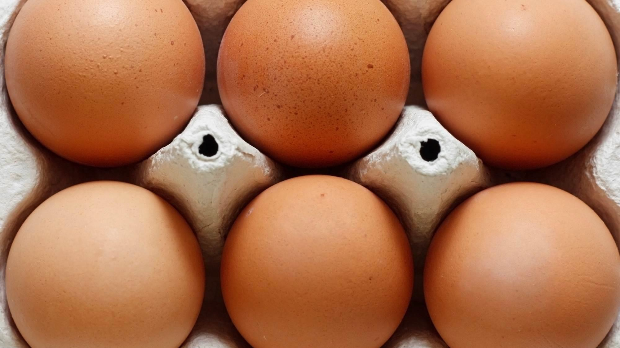
Organic egg production
Sale of organic eggs has grown tremendously in recent years
In 2017, the number of collected organic eggs was 19.2 million kg or 28.4% of all eggs collected at packing facilities
In 2017, organic eggs accounted for 32% of the total number of table eggs sold in retail stores
Animal welfare is the main reason why consumers buy organic eggs

Slide 19
Collection of organic eggs
Million kg
25
24.0 Million
20
15
10
5
0
2007 2008 2009 2010 2011 2012 2013 2014 2015 2016 2017 2018 2019 2020
Source: Statistics Denmark Best estimates for 2018-2020

Slide 20
Organic share of total agricultural production, 2017
Per cent
35
30
25
Eggs:
19.2 million kg
20
Milk: 594 million kg
Broilers: 1,300,000
Pigs: 168,000
15
10
5
0
Eggs
Vegetables
Milk
Cattle
Poultry
Pork
Source: L&F estimates. Provisional .

Slide 21
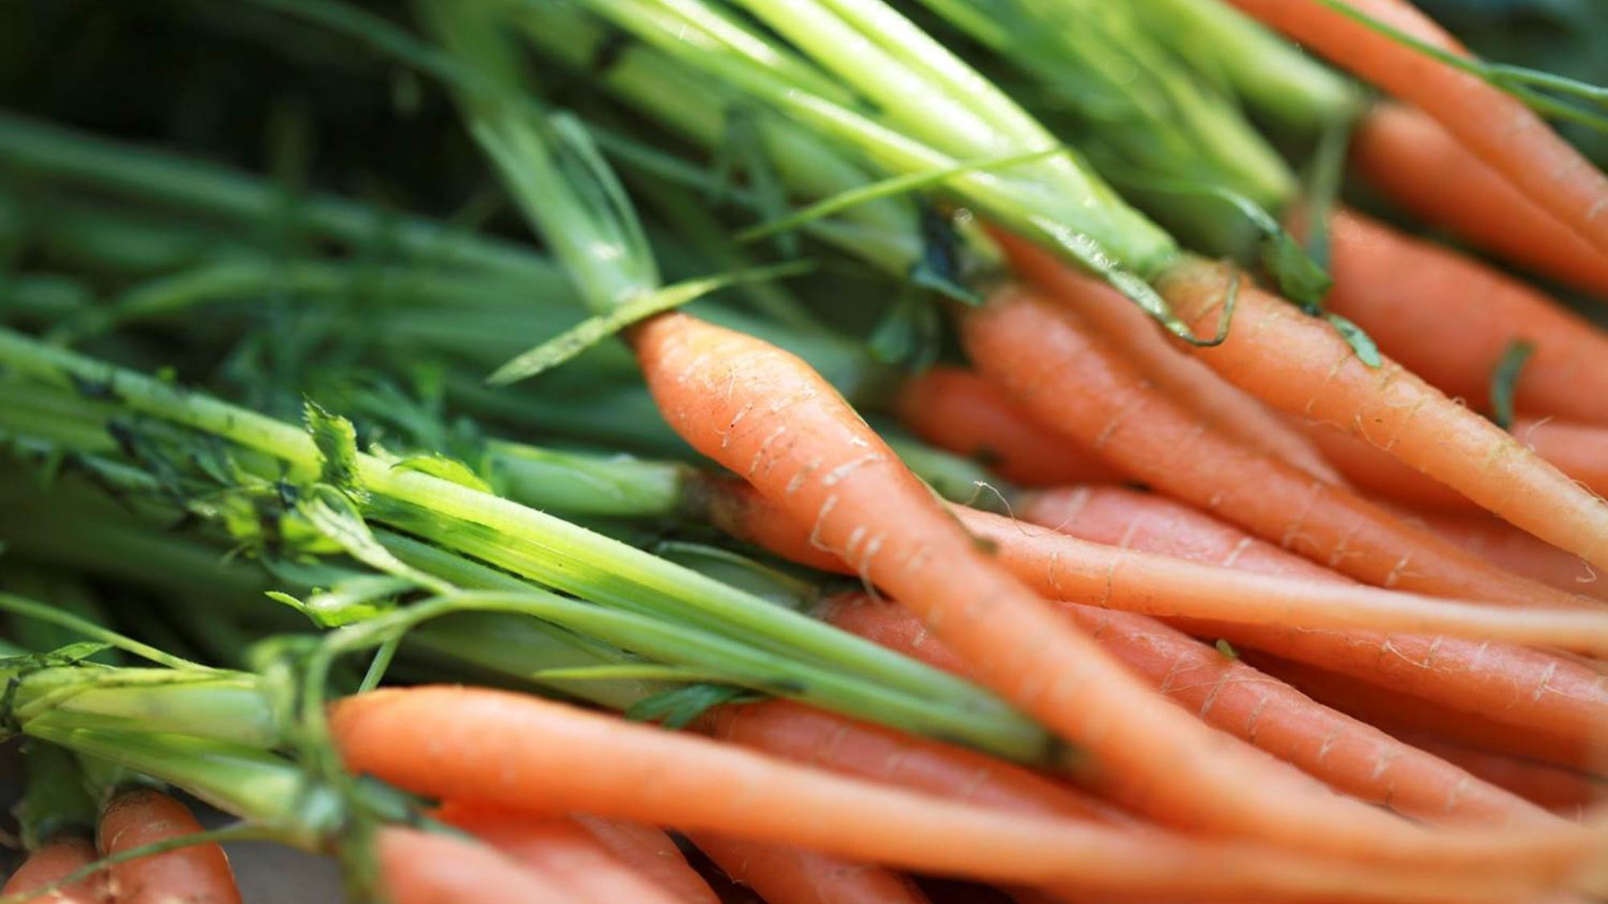
Organic food market and consumption

Slide 22
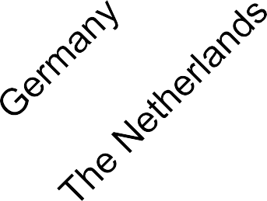
Top 10 organic share of retail sales in 2017
Percent 14
13
12
11
10
9
8
7
6
5
4
3
2
1
0
Source : National statistics (some figures are provisional)
*China has been included for comparison

Slide 23
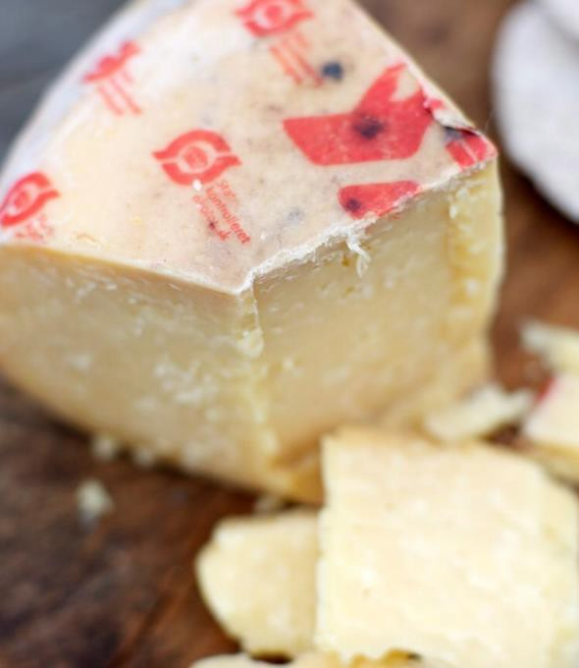
Denmark = World Champion in organic food
Denmark has the highest market share (13.3% in 2017) in the world of organic
food and beverages.
Per capita consumption of organic food was 2,500 DKK in 2017 ~ 335 €
It is the second highest in the world.
Over 2,600 canteens and restaurants (large scale kitchens) have ‘eating-out’ label → it means more than 30 % of the food are organic.
Organic sales have grown every year in the past decade. Growth rate in retail was 14% in 2017
93% of all Danes buy organic products from time to time.
51% of all Danes bought organic food every single week in 2017

Slide 24
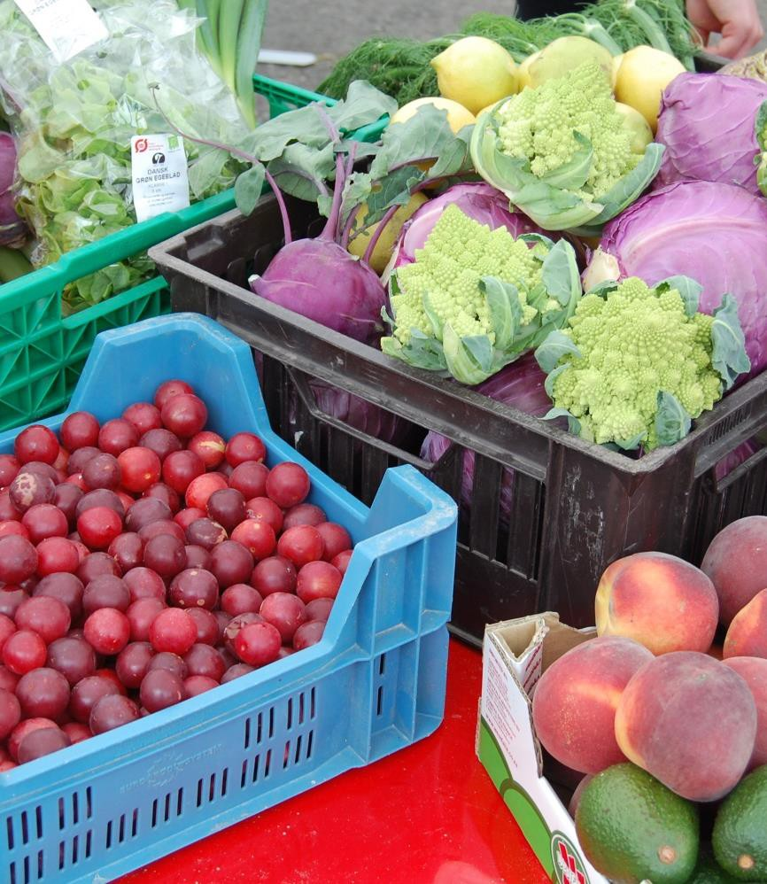
Distribution of organic sales in Denmark, 2017
0,7
2
Retail and online
Food service
Other*
11,3
Total sales reached DKK 14.0 billion ~ 1.88 billion €
* Food markets, farm shops, etc.

Slide 25
Total sale of organic products in Denmark
DKK in Billion
20
18
16
14
12
10
8
6
4
2
0
19.0 Billion
14.0 Billion
2008 2009 2010 2011 2012 2013 2014 2015 2016 2017 2018 2019 2020
Source: Statistics Denmark and Organic Denmark. Danish Agriculture & Food Council’s best estimates for 2018-2020 Total sale includes sale via retail, online, foodservice and others

Slide 26
The ”organic stairs” in Denmark
Ice-cream & Cake
Wine
Beer & Soda
Chocolate
Coffee & Juice
Bread
Beef
Flour & Pasta
Oatmeal
Pork
Eggs Milk
Fruit
Vegetables

Slide 27
What do the Danes eat?
Market shares for organic food in 2017
Product | Share | Product | Share
Oatmeal | 52.3% | Orange | 27.7%
Carrots | 42.3% | Tomatoes | 14.0%
Eggs | 32.6% | Beef | 8.6%
Milk, liquid | 31.6% | Coffee | 7.0%
Bananas | 30.6% | Chicken | 4.1%
Wheat flour | 30.1% | Pork | 3.5%
Source: GfK ConsumerScan

Slide 28
The Organic Cuisine Labels (‘eating out’)
Danish certification system for large-scale kitchens (restaurants, school kitchens, catering etc.)
Share of organic raw material used in the kitchen, measured by cost or weight:
Gold
Silver
Bronze
16%
37%
47%
As at November 2018, a total of 2,600 large-scale kitchens have the Organic Cuisine Label

Slide 29
Main reasons for buying organic food
Fewer residues from spraying
Improved animal welfare Better environment and drinking water
Health Less climate impact
Quality
Fewer additives
0%
15%
30%
45%
60%
Source: Interviews and analyses, L&F 2018

Slide 30
Danish organic trade
Million Euro
2017
Germany and Sweden: 57 % of total exports
600
500
483
400
375
Asia: 13% of total exports
300
Germany and Netherlands: 40% of imports
200
100
Asia: 8% of total import
0
2007 2008 2009 2010 2011 2012 2013 2014 2015 2016 2017
Exports Imports
Source: Statistics Denmark 2017 are best estimates.

Slide 31
Danish import and export of organic food in 2016
DKK million
1400
1200
1000
800
Import
600
Export
400
200
0
Source: Statistics Denmark
* Mainly milk powder and baby food but also sauces, dressing, pastas, etc.
Dairy | Meat | Grain | Feed | Fruit & | Special food* | Coffee, tea,
 |  |  |  | Vegetables |  | etc.

Slide 32
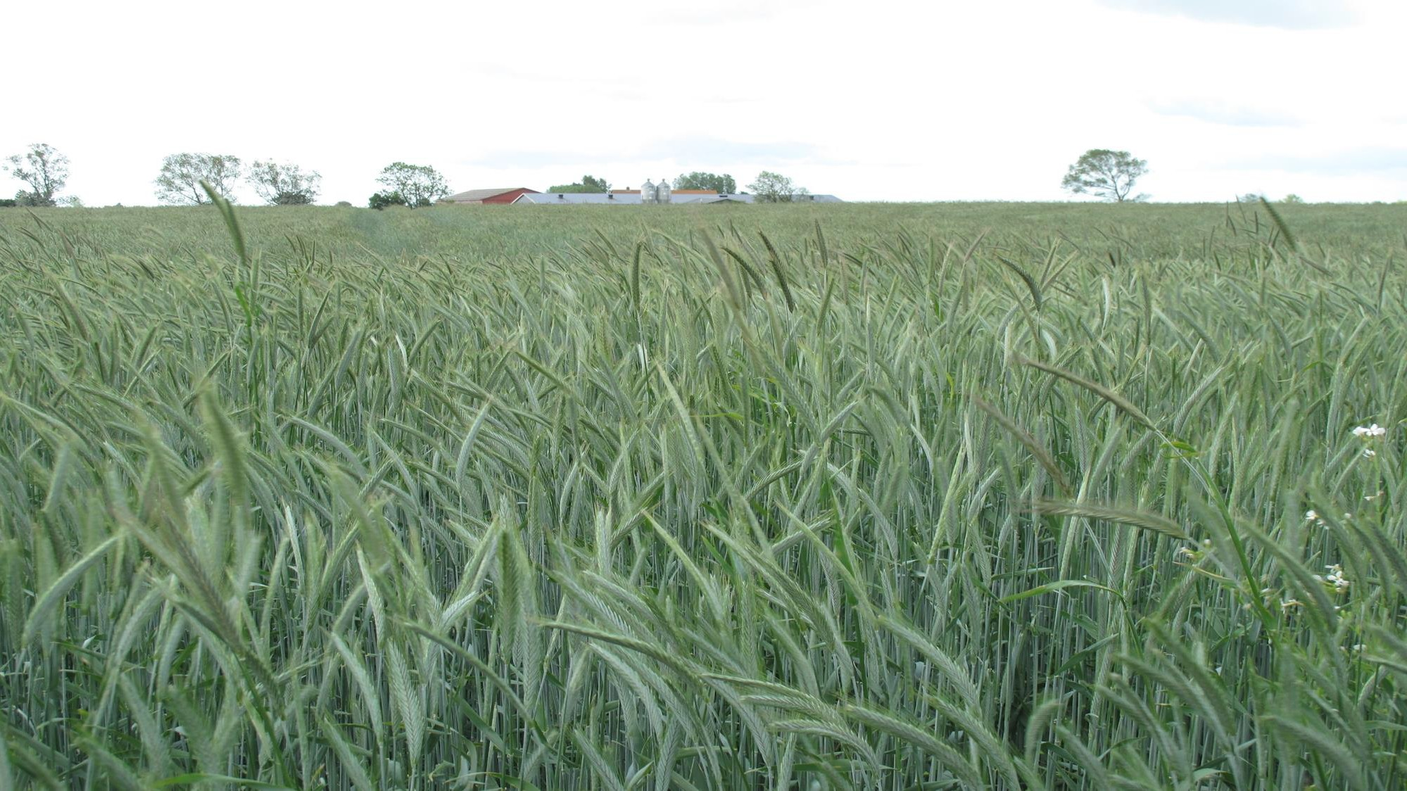
Danish policy to promote organic farming

Slide 33
Important elements in the Danish certification system
100% state certification system since 1987 ensuring high consumer
confidence
Inspections are carried out by national state inspectors
All operators must be authorized by the Danish AgriFish Agency (farms) or the Veterinary and Food Administration (companies)
All organic operators are inspected at least once a year
Additional ad-hoc inspections (risk-based)
All operators are listed on websites (www.fvst.dk and www.lfst.dk )
Inspection reports of food companies on website → Good
transparency
Certification and inspections are 100% free for farmers and companies

Slide 34
Policy to promote organic farming
Subsidies for organic farming:
275 Euros per hectare in the two ‘transition years’
115 Euros per hectare in the following years
Free organic certification and state inspection
More organic action plans since 1987

Slide 35
Policy to promote organic farming
The most recent initiative is the ‘Organic Action Plan 2020’ with a push and pull
strategy:
Financial support for “organic conversion checks”
Subsidy for conversion of public kitchens from conventional food to organic
food, including education of kitchen staff
Subsidy for marketing and information campaigns in Denmark
Subsidy for export promotion
Subsidy for organic research

Slide 36
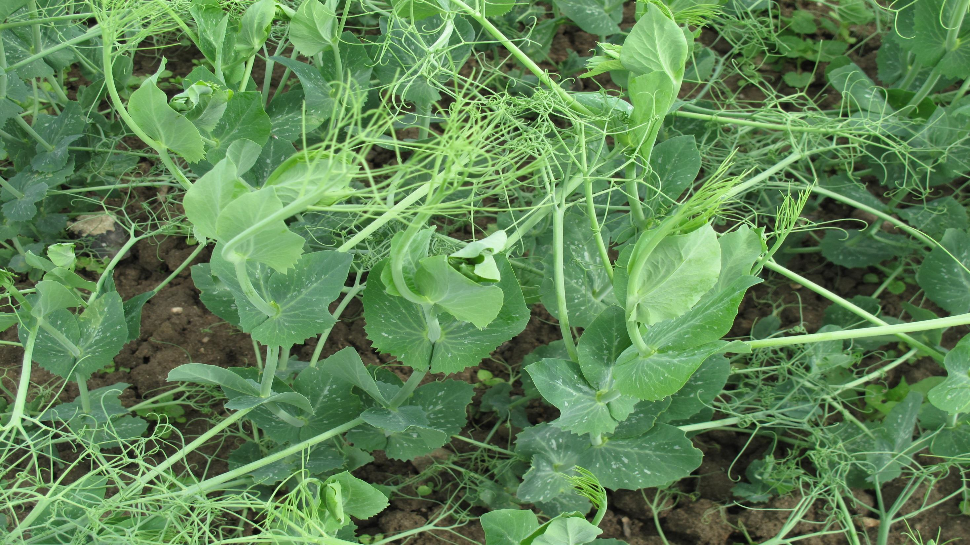
Thank you for your attention！

